Slide 1

Movie Revenue Analysis
Data Visualization Project
By:
Mohaib & Neetu

Slide 2

Research Questions:
Is a movie's revenue dependent on the ratings it earns?
Is the count of votes a key factor towards a movie's ratings?
Are there some genres that earn higher revenue despite receiving lesser votes or ratings?
Is there a correlation between a movie's ratings and revenue and count of votes and revenue?

Slide 3

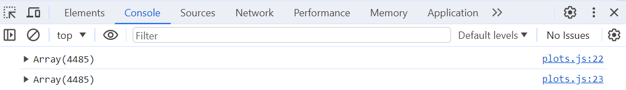
Dataset from:

Slide 4

Fetching Data from SQL into app.py

Slide 5
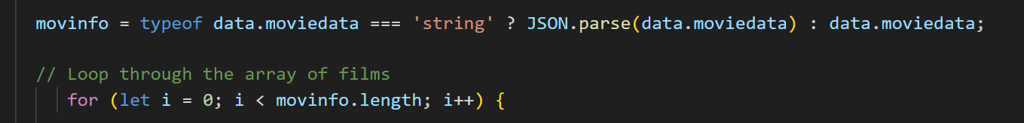
Fetching Data from app.py into js

Slide 6

Creating HTML Page

Slide 7

Questions?

